Slide 1
Module IV

Slide 2
contents
Software Reliability, Testing and Maintenance
Failure and Faults, Reliability Models: Basic Model, Logarithmic Poisson Model, Software process, Functional testing: Boundary value analysis, Equivalence class testing, Decision table testing, Cause effect graphing, Structural testing: path testing, Data flow and mutation testing, unit testing, integration and system testing, Debugging, Testing Tools, & Standards. Management of maintenance, Maintenance Process, Maintenance Models,
Reverse Engineering, Software RE-engineering

Slide 3
Software Reliability
Software reliability is the probability that a software system will operate without failure for a specified period in a defined environment. Unlike hardware reliability, it is not physical but depends heavily on the design and human factors during development. Key elements include:
Probability of failure-free operation.
A specific length of time the software is expected to operate without a major failure.
A specified operational environment.
Reliability is measured using various metrics, such as:
Mean Time to Failure (MTTF): The average time between consecutive failures.(It is the average length of time the software runs without crashing. )
Mean Time to Repair (MTTR): Measures recovery speed. It tracks how long it takes for the technical team to fix a bug and restore service after a failure occurs. Low MTTR is critical for high availability.
Failure Rate (λ): The number of failures per unit time.

Slide 4
Software Reliability Testing
The reliability testing is a testing technique that analyzes the capacity of the software to perform its desired function persistently, and without errors for a prolonged period of time. It determines, and fixes problems that can cause the software to fail or to become unusable. The reliability testing is segregated into three groups such as modeling, measurement and improvement.
The reliability testing is done to identify if the software can execute without any bugs for a particular duration of time in a fixed environment. It confirms whether the software is performing as expected without any issues, and is reliable to use. It is a very critical part of software testing as it helps to confirm if the system meets customer requirements for an extended period of time. Moreover, the reliability testing enables determination of the defects namely performance problems, memory leaks that may not get detected at the time of functional testing.

Slide 5
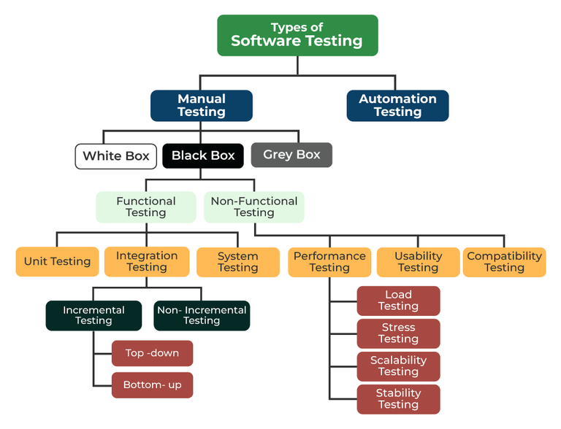

Slide 6
Ways To Perform The Software Reliability Testing
Stress Testing: In this type of testing, the ability of the software is analyzed under a bigger load which is above the normal limits.
Endurance Testing: It is performed at the time of performance testing to verify whether the software is capable of withstanding the load it is expected to bear for a long period of time.
Recovery Testing: It is conducted to test how well a software can handle crashes, and other unanticipated circumstances.
Environmental Testing: It is conducted to test if the software works well in environmental configurations namely temperature and humidity changes, vibrations etc.
Performance Testing: It is conducted to verify the performance of software, and identify issues related to it.
Regression Testing: It is conducted to verify if a new defect is introduced due to new code changes introduced in the software.
Fault Tree Analysis: It is conducted to evaluate the factors that lead to software failures by determining the potential failure modes and analysing the links among them.

Slide 7
Objectives of Software Reliability Testing
The reliability testing determines the permanent structure of the repeated errors in the software.
The software reliability testing counts the total number of failures encountered in a particular period of time.
The software reliability testing identifies the root cause of the failures.
The reliability testing helps to perform performance testing of numerous components of the software after resolving the bugs.
The reliability testing builds the trust, confidence, and faith of the stakeholders, and customers on the software by delivering quality, and solving the customers needs.
The reliability testing analyzes whether the software can be used consistently without compromising on the security, reliability, performance, dependability etc.
The reliability testing ensures that in the absence of unforeseen shutdown or degradation, the software operates with a constant performance level under certain operating conditions.

Slide 8
Failure and Faults, Reliability Models
The existence of faults in the software causes software failure. However, software defects do not always imply that the system will fail. System failures are critical, and their recovery is expensive because they sometimes harm software and the hardware, and in the worst-case scenario, the hardware is entirely destroyed. However, not every software failure leads to a situation like this, but many do. Also, if the program fails to meet the user requirements that it was designed to fulfil, it is labelled a software failure.
Bugs, ambiguities, oversights, or misinterpretations of the software's criteria are supposed to meet cause software failure. Carelessness or incompetence in writing code, insufficient testing, inappropriate or unanticipated software usage, or other unforeseen problems can also be the reason for software failure.
As a result, software failures were categorised to ascertain their hardware behaviour and features, such as whether or not they were recoverable.

Slide 9
Types of Software Failures
Transient failure:
Only specific input values result in transient software failures. These values often fall outside the system's acceptable range, resulting in system failure. As a result, the program is checked for both acceptable and erroneous inputs during testing to ensure that the software's behaviour and reliability are examined. Thus, such scenarios are avoided to the maximum extent possible.
Permanent failure:
All input values are affected by this type of software failure. In such circumstances, an error-prone function is invoked via internal calling, and the error in it causes the failure. Infinite loops in the function, for example, lead the system to carry added strain, which results in complete system failure when it surpasses the limit.
Recoverable failure: (DEADLOCK)
Recoverable system failures occur when they fail to respond to any user's commands for some time. In such circumstances, the system will typically hang, not operate, and the screen may go blank. After a while, the system will attempt to remedy the issue, and the software will begin to function again.
Unrecoverable failure:
The most substantial hardware damage is frequently caused by unrecoverable software. When this software fails, it is unable to recover. Most of the time, they destroy hardware components or necessitate the system to be restarted, causing unpredictable behaviour in other ongoing apps.
Cosmic failure: (glitch)
The least harmful classification of software failures is cosmic. They don't seem to cause any issues with other software or hardware. They may cause minor inconveniences, such as causing the mouse to become stuck in one location for an extended period, and so on. In this form of software failure, no inaccurate results are provided.

Slide 10
Software reliability models
Software reliability models (Basic and Logarithmic Poisson) estimate software quality over execution time.
The Basic Model assumes a finite number of total faults and a linear decrease in failure intensity as faults are fixed.
The Logarithmic Poisson Model assumes a decreasing exponential reduction in failure intensity, making it more accurate for complex systems where earlier, high-impact fixes reduce risk faster.
Both models are generally based on a Non-Homogeneous Poisson Process (NHPP), which describes the reliability growth of a system over time, where the number of failures changes as a function of time, according to.

Slide 11
Cont.
The Basic and Logarithmic Poisson Execution Time Models, developed by J.D. Musa, are software reliability models predicting failures based on execution time.
The Basic Model assumes a constant failure intensity reduction per failure, whereas the Logarithmic Model assumes an exponential reduction, making it better suited for projects where early failures reduce intensity significantly

Slide 12
Cont.
The basic execution time model in software reliability focuses on estimating the time it takes for a software program to execute successfully without failing or encountering errors.
Unlike the previous basic execution time model, which focuses on estimating the actual execution time of a program, this model is centered around predicting how long a software system can run reliably without encountering failures or errors.
The basic execution time model in software reliability focuses on estimating the reliability and availability of a software system over time. It considers both the ability to operate without errors (MTBF) and the ability to recover quickly from errors (MTTR), along with factors like redundancy, fault tolerance, and error recovery mechanisms.

Slide 13

Basic Execution Time Model (Musa-Okumoto)
Musa Basic Execution Time Model, a fundamental software reliability model developed by J.D. Musa in 1979. This model is based on the concept of a Non-Homogeneous Poisson Process (NHPP), which assumes that failures occur randomly over time, but the rate at which they occur (failure intensity) changes as faults are detected and fixed.
The Failure Intensity Formula
The model uses a specific formula to represent the relationship between the number of failures and the intensity of those failures:

Slide 14
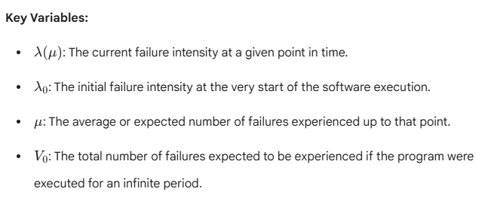
Cont..

Slide 15
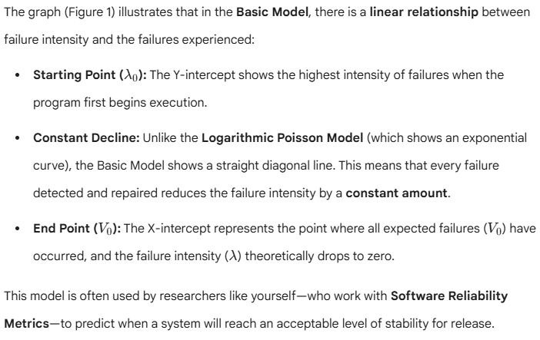
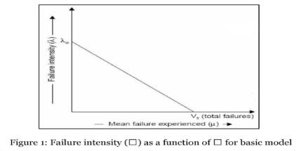

Slide 16
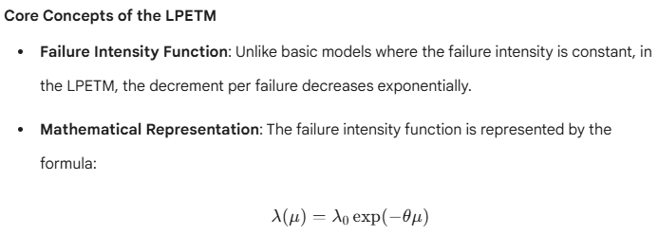
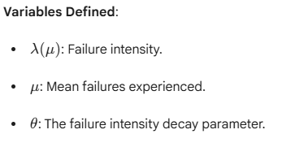
Logarithmic Poisson Model
Logarithmic Poisson Execution Time Model (LPETM) developed by J.D. Musa et al., which is used to model software reliability based on failure intensity.

Slide 17
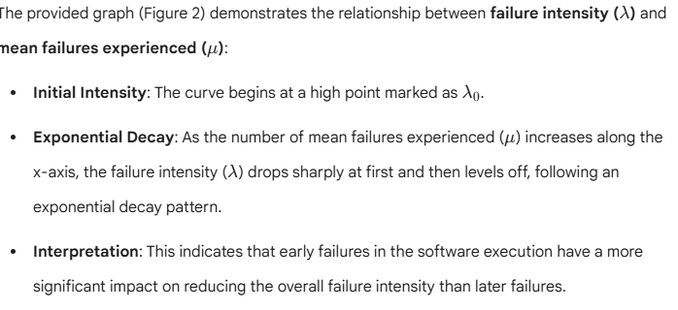
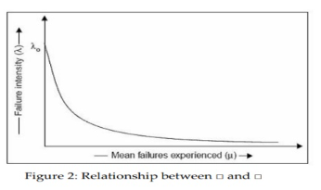

Slide 18
Cont.
LPETM is a mathematical model used in software reliability engineering to estimate software reliability by analyzing fault detection and removal processes over time.
This model takes into account both the fault removal process (detection and correction of defects) and the software reliability growth process. The LPETM is an improvement over earlier models like the NHPP (Non-Homogeneous Poisson Process) model.
Using the LPETM, software reliability engineers can estimate the software's reliability over time, calculate metrics like the Mean Time Between Failures (MTBF), and make predictions about future reliability based on the fault arrival rate, fault detection rate, and defect removal efficiency. The goal is to improve software reliability by monitoring and optimizing the fault removal process.

Slide 19
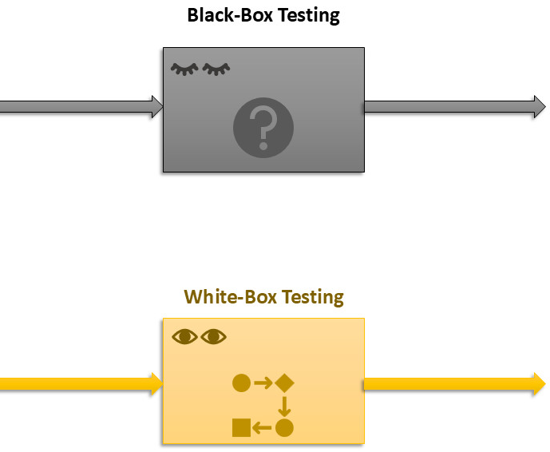
Testing Types
The terms you listed refer to specific software testing techniques falling under two main categories,
Functional (black-box) and Structural (white-box) testing, as well as different levels of testing.

Slide 20
Cont.
Functional testing (black-box) verifies external behavior without knowledge of the internal code, while structural testing (white-box) examines the internal code and structure. Both are used at different levels of testing which progress through the software development lifecycle.

Slide 21
Functional (Black-Box) Testing
Functional testing is a software testing method in which the internal structure or workings of the application are hidden from the tester. It focuses on the software's functionality and validates it against specified requirements from the end-user's perspective.
Focus: Input and expected output, user interface, and overall behavior.
Knowledge Required: No knowledge of the internal code or programming is needed.
Performed By: Typically performed by independent software testers.
Techniques: Common techniques include Equivalence Partitioning, Boundary Value Analysis, and Error Guessing.

Slide 22
Structural (White-Box) Testing
Structural testing is a method where the tester has full knowledge of the internal code, structure, and design of the application. It is also referred to as "clear box" or "glass box" testing.
Focus: Internal logic, code paths, data flow, and data structures.
Knowledge Required: Requires programming skills and an understanding of the software architecture.
Performed By: Typically performed by developers.
Techniques: Common techniques include statement coverage, branch coverage, and path testing.

Slide 23
Levels of Testing
Software testing is typically conducted across four main levels, following a hierarchical approach:
Unit Testing: The first level of testing, where individual components or modules of the software are tested in isolation by the developers to ensure they function as intended. This is primarily a form of white-box testing.
Integration Testing: After unit testing, this level verifies that different modules work together correctly when integrated, focusing on the interfaces and data flow between them. This can involve both white-box and black-box approaches.
System Testing: Once the entire system is integrated, it is tested as a whole to ensure it meets all specified functional and non-functional requirements in a production-like environment. This level is typically black-box testing and is performed by the testing team.
Acceptance Testing: The final level of testing performed by the actual customers or end-users to verify if the system meets their business needs and is ready for deployment. This is a type of black-box testing (User Acceptance Testing).

Slide 24
Functional testing: Boundary value analysis, Equivalence class testing,
Boundary Value Analysis (BVA) and Equivalence Class Partitioning (ECP) are two complementary black-box functional testing techniques used to minimize the number of test cases needed while maximizing coverage of input data scenarios.

Slide 25
Equivalence Class Partitioning (ECP)
It is also termed Equivalence Class Partitioning (ECP). It is a Black Box Testing technique, where a range of input values are divided into equivalence data classes. In this, the tester tests a random input value from the defined interval of equivalence data classes and if the output for that input value is valid, then the whole class interval is considered valid and vice-versa.
Example: An application allow the user to enter the password of length 8-12 numbers (minimum 8 and maximum 12 numbers).
Invalid Equivalence Class | Valid Equivalence Class | Invalid Equivalence Class
<8 | 8-12 | >12

Slide 26
Cont.
Let's consider some password values for valid and invalid class
  1234 is of length 4 which is an invalid password as 4<8.
  567890234 is of length 9 which is a valid password as 9 lies between 8-12
  4536278654329 is of length 13 which is an invalid password as 13>12.
Valid Equivalence Classes: Ranges or sets of input data that the system is designed to accept and process correctly (e.g., ages 18-60).
Invalid Equivalence Classes: Ranges or sets of input data that the system is expected to reject or handle with an error (e.g., ages less than 18 or greater than 60).
Benefit: ECP significantly reduces the total number of test cases required, making testing more efficient without sacrificing broad coverage.

Slide 27
Boundary Value Analysis (BVA)
Used to check the behaviour of an application using test data that exists at boundary values, or in other words, for a range of input data values, boundary values (end values) are used as input for testing. It is mostly used as a design technique, as it is believed that software is most likely to fail at the upper and lower limits of input data values.

Slide 28
Cont.
Example: A software allows people aged 20 to 50 years (both 20 and 50 are inclusive) to fill a form, for which the user has to enter his age in the age field option of the software.
The boundary values are 20 (min value) and 50 (max value).
In the above table, one can clearly identify all valid and invalid test values (values consider during testing the system).
Valid value: Test values at which the system does not fail and function properly as per user requirement.
Invalid Values: test values that do not meet the system requirement.
Invalid Value (min-1) | Valid Value (min, min+1, nominal value, max-1, max) | Invalid Value (max+1)
19 | 20, 21, 30, 49, 50 | 51

Slide 29
Decision table testing,
A decision table is a brief visual representation for specifying which actions to perform depending on given conditions. This article focuses on discussing decision tables in detail.
What is a Decision Table?
A decision table is a good way to settle different combination inputs with their corresponding outputs and is also called a cause-effect table.
The reason to call the cause-effect table is a related logical diagramming technique called cause-effect graphing that is used to obtain the decision table.
The information represented in decision tables can also be represented as decision trees or in a programming language using if-then-else and switch-case statements.

Slide 30
Decision Table in Test Designing
Decision Table
CONDITIONS STEP 1 STEP 2 STEP 3 STEP 4
Condition 1 Y Y N N
Condition 2 Y N Y N
Condition 3 Y N N Y
Condition 4 N Y Y N

Slide 31
Advantages of Decision Table
Easy conversion of business flow to test case: Any complex business flow can be easily converted into test scenarios and test cases using this technique.
Works iteratively: Decision tables work iteratively which means the table created at the first iteration is used as input tables for the next tables. The iteration is done only if the initial table is not satisfactory.
Simple to understand: Simple to understand and everyone can use this method to design the test scenarios & test cases.
Provides complete test case coverage: It provides complete coverage of test cases which helps to reduce the rework on writing test scenarios & test cases.
Guarantees every combination is considered: These tables guarantee that we consider every possible combination of condition values. This is known as its completeness property.

Slide 32
Cause effect graphing,
Cause Effect Graphing based technique is a technique in which a graph is used to represent the situations of combinations of input conditions.
The graph is then converted to a decision table to obtain the test cases.
Cause-effect graphing technique is used because boundary value analysis and equivalence class partitioning methods do not consider the combinations of input conditions.
But since there may be some critical behaviour to be tested when some combinations of input conditions are considered, that is why cause-effect graphing technique is used

Slide 33
Steps used in deriving test cases using this technique are:
Division of specification: Since it is difficult to work with cause-effect graphs of large specifications as they are complex, the specifications are divided into small workable pieces and then converted into cause-effect graphs separately.
Identification of cause and effects: This involves identifying the causes(distinct input conditions) and effects(output conditions) in the specification.
Transforming the specifications into a cause-effect graph: The causes and effects are linked together using Boolean expressions to obtain a cause-effect graph. Constraints are also added between causes and effects if possible.
Conversion into decision table: The cause-effect graph is then converted into a limited entry decision table.
Deriving test cases: Each column of the decision-table is converted into a test case.

Slide 35
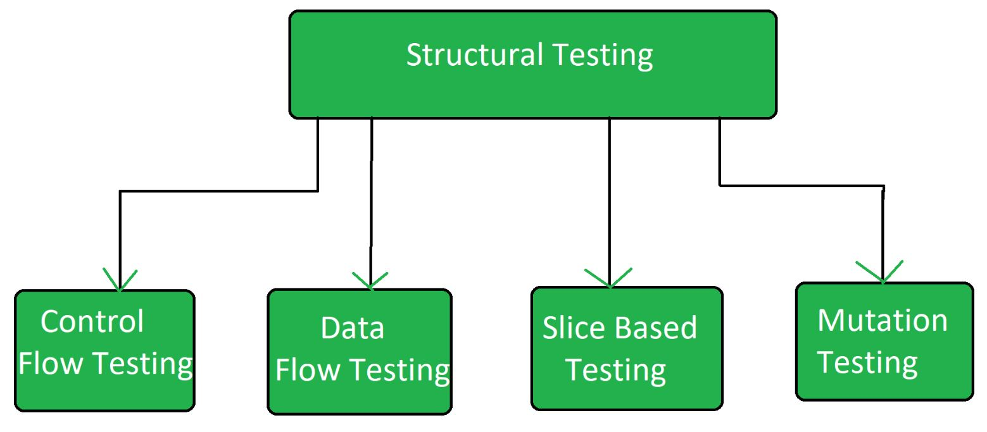
Structural Software Testing
Structural testing is a type of software testing that uses the internal design of the software for testing or in other words the software testing which is performed by the team which knows the development phase of the software, is known as structural testing.

Slide 36
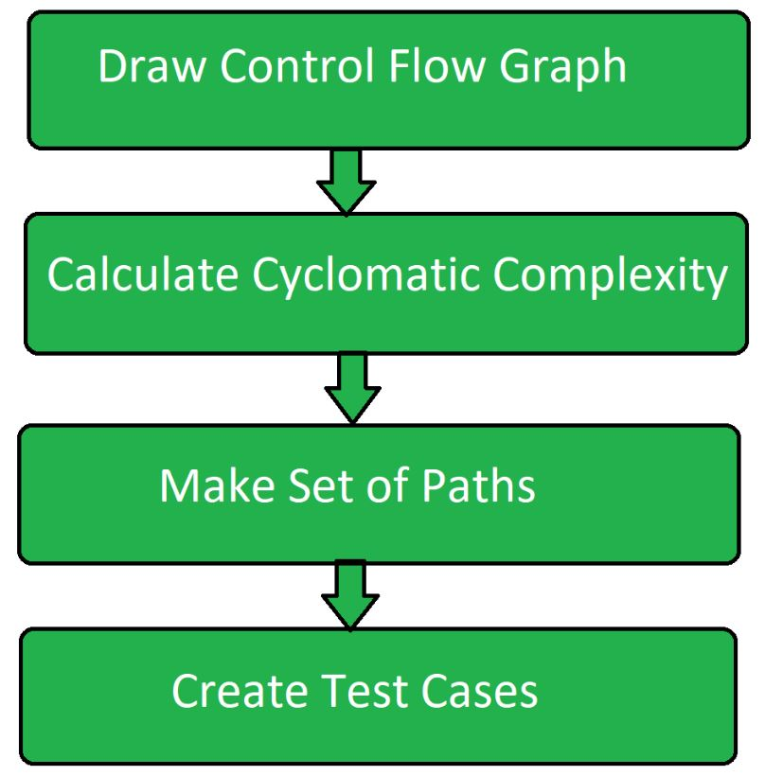
Core Structural Testing Techniques
Path Testing: A technique that focuses on executing all possible independent execution paths within a program's control flow. This is achieved by creating a control flow graph of the program to determine the minimum number of test cases required to cover every statement and branch, often using the Cyclomatic Complexity metric.

Slide 37
Path Testing Techniques
Control Flow Graph:
The program is converted into a control flow graph by representing the code into nodes and edges.
Decision to Decision path:
The control flow graph can be broken into various Decision to Decision paths and then collapsed into individual nodes.
Independent paths:
An Independent path is a path through a Decision to Decision path graph that cannot be reproduced from other paths by other methods.
Advantages of Path Testing
The path testing method reduces the redundant tests.
Path testing focuses on the logic of the programs.
Path testing is used in test case design.
Disadvantages of Path Testing
A tester needs to have a good understanding of programming knowledge or code knowledge to execute the tests.
The test case increases when the code complexity is increased.
It will be difficult to create a test path if the application has a high complexity of code.
Some test paths may skip some of the conditions in the code. It may not cover some conditions or scenarios if there is an error in the specific paths.

Slide 38
Data Flow Testing
Data Flow Testing is a type of structural testing . It is a method that is used to find the test paths of a program according to the locations of definitions and uses of variables in the program. It has nothing to do with data flow diagrams. Furthermore, it is concerned with:
Statements where variables receive values,
Statements where these values are used or referenced.
By analyzing control flow graphs, this technique aims to identify issues such as unused variables or incorrect definitions, ensuring proper handling of data within the code

Slide 39
Mutation Testing
Mutation Testing is a white box Testing technique that helps compare the effectiveness of existing tests and design new ones. Making small modifications (mutations) in the source code, mutation testing aims to identify weaknesses in test cases and verify that all parts of the program are properly tested with their functionalities.
Mutation Testing was introduced by Richard Lipton in 1971. While the high cost initially limited its use, but now it is widely used in languages like Java and XML, proving its effectiveness in software testing.

Slide 40
Objective of MT
To identify pieces of code that are not tested properly.
To identify hidden defects that can't be detected using other testing methods.
To discover new kinds of errors or bugs.
To calculate the mutation score.
Understand how errors spread within the program.
Assess how well the test cases perform.

Slide 41
Testing Levels
Unit, integration, and system testing are levels of testing, and can employ both structural (white-box) and functional (black-box) techniques:
Unit Testing This is the first level of testing and involves testing individual components or sections (units) of the software to ensure they work as intended. It is typically performed by developers and heavily relies on structural testing techniques because they have access to the source code.
Integration Testing This level focuses on testing the interfaces and interactions between different integrated modules or components to ensure they work together as a system. Both structural and functional approaches can be used.
System Testing This level involves testing the complete, integrated software product in an environment that mimics real-world use to verify that it meets the specified requirements. This is primarily a black-box (functional) testing effort, as the focus is on the system's external behavior and functionality rather than internal code structure.

Slide 42
Unit testing
A unit test is a small piece of code that checks if a specific function or method in is an application works correctly. It will work as the function inputs and verifying the outputs. These tests check that the code work as expected based on the logic the developer intended.
In these multiple tests are written for a single function to cover different possible scenarios and these are called test cases. While it is ideal to cover all expected behaviors, it is not always necessary to test every scenario.
Unit tests should run one by one, it means that they do not depend on other system parts like databases or networks. Instead, data stubs can be used to simulate these dependencies. Writing unit tests is easiest for simple, self-contained code blocks.

Slide 43
Unit testing strategies
Logic checks: Verify if the system performs correct calculations and follows the expected path with valid inputs. Check all possible paths through the code are tested.
Boundary checks: Test how the system handles typical, edge case, and invalid inputs. For example, if an integer between 3 and 7 is expected, check how the system reacts to a 5 (normal), a 3 (edge case), and a 9 (invalid input).
Error handling: Check the system properly handles errors. Does it prompt for a new input, or does it crash when something goes wrong?
Object-oriented checks: If the code modifies objects, confirm that the object's state is correctly updated after running the code.

Slide 44
Integration Testing
Integration Testing is a Software Testing Technique that focuses on verifying the interactions and data exchange between different components or modules of a Software Application. The goal of Integration Testing is to identify any problems or bugs that arise when different components are combined and interact with each other.
It mainly tests interface between two software units or modules. It focuses on determining the correctness of the interface. Once all the modules have been unit-tested, integration testing is performed.
Integration testing can be done by picking module by module. This can be done so that there is a proper sequence to be followed.
Exposing the defects is the major focus of the integration testing and the time of interaction between the integrated units.

Slide 45
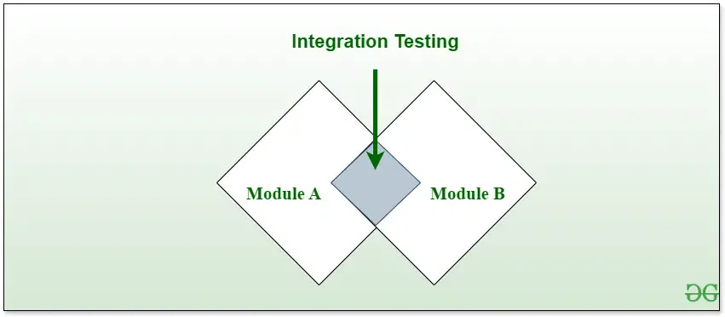
Steps to Integration testing
Identify the components to be tested
Determine the test objectives
Define the test data
Design the test cases
Develop test scripts
Set up the testing environment
Execute the testsEvaluate the results

Slide 46
System Testing
System Testing is a type of software testing that is performed on a completely integrated system to evaluate the compliance of the system with the corresponding requirements. In system testing, integration testing passed components are taken as input.
The goal of integration testing is to detect any irregularity between the units that are integrated. System testing detects defects within both the integrated units and the whole system. The result of system testing is the observed behavior of a component or a system when it is tested.
System Testing is carried out on the whole system in the context of either system requirement specifications or functional requirement specifications or the context of both. System testing tests the design and behavior of the system and also the expectations of the customer.
It is performed to test the system beyond the bounds mentioned in the software requirements specification (SRS). System Testing is performed by a testing team that is independent of the development team and helps to test the quality of the system impartial.
It has both functional and non-functional testing. System Testing is performed after the integration testing and before the acceptance testing.

Slide 47
Debugging
Debugging is the process of identifying, analyzing, and resolving errors (bugs) in a software system to ensure it functions correctly. It typically follows the testing phase, where testers find the bugs, and developers then fix them.
Debugging Process Steps
Reproduce the Bug: Recreate the exact conditions under which the error occurred to observe it firsthand and gather data.
Locate the Bug: Pinpoint the specific section or line of code responsible for the issue using tools like debuggers and log files.
Identify the Root Cause: Analyze the logic and flow of the code to understand why the bug occurred in those specific conditions.
Fix the Bug: Make the necessary changes to the code to rectify the problem.
Validate the Fix: Run various tests (unit, integration, regression) to ensure the bug is resolved and no new issues were introduced.
Document the Process: Record details about the bug, its cause, and the solution for future reference and team knowledge sharing.

Slide 48
Debugging Tools
Integrated Development Environments (IDEs): Tools like Visual Studio, Eclipse, and PyCharm offer built-in debuggers with features like breakpoints and variable inspection.
Standalone Debuggers: Powerful, versatile command-line tools such as GDB (GNU Debugger) that provide advanced functionality.
Memory Debuggers: Tools like Valgrind help identify memory-related issues such as leaks or buffer overflows.
Browser Developer Tools: Integrated tools in browsers like Chrome DevTools for debugging web applications by inspecting HTML, CSS, and JavaScript.

Slide 49
Testing Tools
Software testing tools are applications that help automate, manage, and streamline the process of software testing to ensure quality, reliability, and performance. The choice of tool depends heavily on the type of testing (e.g., unit, performance, security) and the platform (web, mobile, desktop) being tested.

Slide 50
Categories of Software Testing Tools
Test Management Tools: These help plan testing activities, organize test cases, track progress, and report quality status. Examples: Jira, TestRail, and Zephyr.
Automation Testing Tools: These are used to execute repetitive tasks automatically, increasing speed and consistency in testing. They can be script-based or codeless. Examples: Selenium (web automation), Appium (mobile apps), and Cypress (modern web apps).
Performance & Load Testing Tools: These tools evaluate the system's performance under various workloads and stress to identify bottlenecks and ensure stability. Examples: Apache JMeter and LoadRunner.
Bug & Issue Tracking Tools Used to log, prioritise, assign, and track defects discovered during the testing process, facilitating effective defect management. Examples: Jira, Bugzilla, and Asana.
Security Testing Tools: These are designed to identify vulnerabilities in the software and protect applications from malicious attacks. Examples: OWASP ZAP, Burp Suite, and SonarQube.
Unit Testing Frameworks Used by developers to test individual units or components of source code in isolation. Examples: JUnit (Java), NUnit (.NET), and PyTest (Python).
API Testing Tools: These verify the functionality, performance, and reliability of Application Programming Interfaces (APIs) and web services. Examples: Postman and SoapUI.

Slide 51
Management of maintenance
Software maintenance is a continuous process that occurs throughout the entire life cycle of the software system.
The goal of software maintenance is to keep the software system working correctly, efficiently, and securely, and to ensure that it continues to meet the needs of the users.
This can include fixing bugs, adding new features, improving performance, or updating the software to work with new hardware or software systems.
It is also important to consider the cost and effort required for software maintenance when planning and developing a software system.
It is important to have a well-defined maintenance process in place, which includes testing and validation, version control, and communication with stakeholders.
It's important to note that software maintenance can be costly and complex, especially for large and complex systems. Therefore, the cost and effort of maintenance should be taken into account during the planning and development phases of a software project.
It's also important to have a clear and well-defined maintenance plan that includes regular maintenance activities, such as testing, backup, and bug fixing.

Slide 52
Software maintenance models
Software maintenance models are structured approaches used to manage, update, and improve software after deployment, ensuring cost-effectiveness and system reliability. Key models include the
Quick-Fix Model (immediate, ad hoc fixes),
Iterative Enhancement Model (incremental changes),
Boehm’s Model (closed-loop, cost-focused), and
Reuse-Oriented Model (modifying components). These models are critical for handling four main types of maintenance: Corrective(Fixing Bugs), Adaptive(Adapting to Changes), Perfective((Improving Enhancements), and Preventive(Preventing Future Issues).

Slide 53
Cont.
Quick-Fix Model: An ad hoc, rapid approach used to address problems immediately after they are identified. It is cost-effective for small, urgent issues but can lead to uncoordinated code if overused.
Iterative Enhancement Model: Involves modifying existing software by analyzing the current system, implementing changes, and updating documentation iteratively. It is suited for modernizing or enhancing applications systematically.
Boehm’s Model: A sophisticated model that approaches maintenance as a closed-loop cycle, emphasizing the "Annual Change Traffic" (ACT) to estimate the effort required for changes.
Reuse-Oriented Model: Focuses on identifying and isolating reusable components from the existing system, then adapting them for new functionality or modified requirements.
Full-Reuse Model: A variation that emphasizes maximal reuse of existing components to reduce the development cost of new features.

Slide 54
Reverse Engineering
Software Reverse Engineering is the process of recovering the design and the requirements specification of a product from an analysis of its code. Reverse Engineering is becoming important, since several existing software products, lack proper documentation, are highly unstructured, or their structure has degraded through a series of maintenance efforts.
Why Reverse Engineering?
Providing proper system documentation.
Recovery of lost information.
Assisting with maintenance.
The facility of software reuse.
Discovering unexpected flaws or faults.
Implements innovative processes for specific use.
Easy to document the things how efficiency and power can be improved.

Slide 55
Uses of Software Reverse Engineering
Software Reverse Engineering is used in software design, reverse engineering enables the developer or programmer to add new features to the existing software with or without knowing the source code.
Reverse engineering is also useful in software testing, it helps the testers to study or detect the virus and other malware code.
Software reverse engineering is the process of analyzing and understanding the internal structure and design of a software system. It is often used to improve the understanding of a software system, to recover lost or inaccessible source code, and to analyze the behavior of a system for security or compliance purposes.
Malware analysis: Reverse engineering is used to understand how malware works and to identify the vulnerabilities it exploits, in order to develop countermeasures.
Legacy systems: Reverse engineering can be used to understand and maintain legacy systems that are no longer supported by the original developer.
Intellectual property protection: Reverse engineering can be used to detect and prevent intellectual property theft by identifying and preventing the unauthorized use of code or other assets.

Slide 56
Advantages of Software Maintenance
Improved Software Quality: Regular software maintenance helps to ensure that the software is functioning correctly and efficiently and that it continues to meet the needs of the users.
Enhanced Security: Maintenance can include security updates and patches, helping to ensure that the software is protected against potential threats and attacks.
Increased User Satisfaction: Regular software maintenance helps to keep the software up-to-date and relevant, leading to increased user satisfaction and adoption.
Extended Software Life: Proper software maintenance can extend the life of the software, allowing it to be used for longer periods of time and reducing the need for costly replacements.
Cost Savings: Regular software maintenance can help to prevent larger, more expensive problems from occurring, reducing the overall cost of software ownership.

Slide 57
Disadvantages of Software Maintenance
Cost: Software maintenance can be time-consuming and expensive, and may require significant resources and expertise.
Schedule disruptions: Maintenance can cause disruptions to the normal schedule and operations of the software, leading to potential downtime and inconvenience.
Complexity: Maintaining and updating complex software systems can be challenging, requiring specialized knowledge and expertise.
Risk of introducing new bugs: The process of fixing bugs or adding new features can introduce new bugs or problems, making it important to thoroughly test the software after maintenance.
User resistance: Users may resist changes or updates to the software, leading to decreased satisfaction and adoption.
Compatibility issues: Maintenance can sometimes cause compatibility issues with other software or hardware, leading to potential integration problems.

Slide 58
Software RE-engineering
Software Re-Engineering is the examination and alteration of a system to reconstitute it in a new form. The principle of Re-Engineering when applied to the software development process is called software re-engineering. It positively affects software cost, quality, customer service, and delivery speed. In Software Re-engineering, we are improving the software to make it more efficient and effective.
It is a process where the software's design is changed and the source code is created from scratch. Sometimes software engineers notice that certain software product components need more upkeep than other components, necessitating their re-engineering.

Slide 60
Steps
Decide which components of the software we want to re-engineer. Is it the complete software or just some components of the software?
Do Reverse Engineering to learn about existing software functionalities.
Perform restructuring of source code if needed for example modifying functional-Oriented programs in Object-Oriented programs
Perform restructuring of data if required
Use Forward Engineering ideas to generate re-engineered software

Slide 61
Advantage
Software re-engineering is an economical process for software development and quality enhancement of the product. This process enables us to identify the useless consumption of deployed resources and the constraints that are restricting the development process so that the development process could be made easier and cost-effective (time, financial, direct advantage, optimize the code, indirect benefits, etc.) and maintainable. The software reengineering is necessary for having-
a) Boost up productivity: Software reengineering increase productivity by optimizing the code and database so that processing gets faster.
b) Processes in continuity: The functionality of older software products can be still used while the testing or development of software.
c) Improvement opportunity: Meanwhile the process of software reengineering, not only software qualities, features, and functionality but also your skills are refined, and new ideas hit your mind. This makes the developer's mind accustomed to capturing new opportunities so that more and more new features can be developed.
d) Reduction in risks: Instead of developing the software product from scratch or from the beginning stage, developers develop the product from its existing stage to enhance some specific features brought in concern by stakeholders or its users. Such kind of practice reduces the chances of fault fallibility.
e) Saves time: As stated above, the product is developed from the existing stage rather than the beginning stage, so the time consumed in software engineering is lesser.
f) Optimization: This process refines the system features, and functionalities and reduces the complexity of the product by consistent optimization as maximum as possible.

